Slide 1

Churn Rate Capstone
Learn SQL from Scratch
By Jessica Hayden

Slide 2
Table of Contents
Getting Familiar with Codeflix: Codeflix’s Operational Months and User Segments
Getting Familiar with Codeflix: How many months have enough information to calculate a churn rate?
The Overall Churn Rate Since Codeflix Started
Comparing the Two User Segments: What User Segment Should They Focus on Expanding?

Slide 3
Getting Familiar with Codeflix:
Codeflix’s Operational Months and User Segments

Slide 4
Codeflix’s Operational Months and User Segments
Codeflix is a video streaming service that has been operational for four months (December 2016 – March 2017) and has two user segments: 87 and 30.
In the dataset that was provided to us, we can figure this out by executing the SQL query displayed below. This query will show us all the data that exists in the subscriptions table (the dataset provided), limited to the first 100 rows
A snapshot of the query result can be found to your right.
select * from subscriptions limit 100;

Slide 5
Getting Familiar with Codeflix:
How many months have enough information to calculate a churn rate?

Slide 6
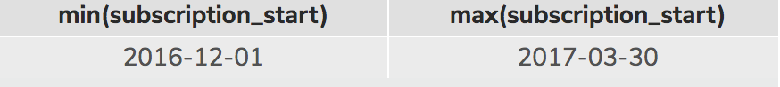
How many months have enough information to calculate Codeflix’s churn rate?
Based on the dataset provided, three out of the four months Codeflix has been operational (January 2017 – March 2017) have enough information to calculate a churn rate.
We can figure this out by executing the SQL query displayed to your right. This query will show us the earliest subscription start date and the latest subscription end date.
A snapshot of the query result can be found below.
select min(subscription_start), max(subscription_start) from subscriptions;

Slide 7
The Overall Churn Rate Since Codeflix Began

Slide 8
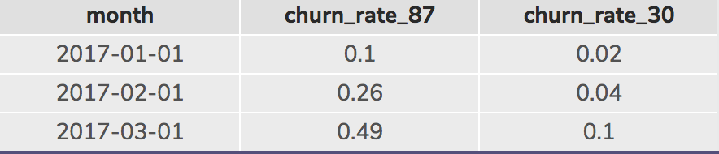
The Overall Churn Rate Since Codeflix Began
To get a company’s churn rate, we calculate this by dividing the number of cancellations during a given time period by the total number of subscribers. In Codeflix’s case, we’re calculating the churn rate for the months of January 2017, February 2017 and March 2017.
In SQL, a snapshot of the query used to get this result is displayed to your right and snapshot of the query result is displayed below.
…
select month, round(1.0 * sum_canceled_87/sum_active_87,2) as churn_rate_87, round(1.0 * sum_canceled_30/sum_active_30,2) as churn_rate_30 from status_aggregate;

Slide 9
Comparing the Two User Segments:
What user segment should Codeflix focus on expanding?

Slide 10
What user segment should Codeflix focus on expanding?
Based on the query results as displayed in the Slide 9, the 87 user segment is experiencing a sharper increase in churn rates than the 30 user segment.
It is my belief that Codeflix should focus on expanding the 30 user segment since they are the user segment that has a lower churn rate and a higher growth opportunity.

